Slide 1

When’s the money?
Time series analysis of online poker traffic
General Assembly Capstone Project - Richard Chadwick

Slide 2
The Goals
Provide players with information or tools they can use to increase their profit
Achieve this without replicating an existing product or service
Bonus: Proof of concept for a commercially viable product

Slide 3

Review the Competition
Collect, Parse and Clean Data
Exploratory Data Analysis
Modelling
Evaluate models

Slide 4



The Competition
Game review
Aggregated player statistics
Advanced poker bots
Notes:
Pokertracker 4 is a tool for storing hand histories and reviewing players, their actions and associated frequencies. Developed over ten years, it is a market leader in providing tools for player analysis.
Sharkscope has the largest database of scraped hands in the world. It provides aggregate statistics on players played games and outcomes via an online search feature. It provides limited customisation (statistics and aggregations are not customisable, filter functionality is limited to dates).
Bonus bots and warbot provide off the shelf poker bots. Although a recent development in the poker market, the use of bots are increasingly obstructed by cheat detection methods employed by poker providers.
First idea for a unique product, as you can guess from the title, was a forecasting tool that helps users choose what times to play.

Slide 5
The Data
Data: Game summaries sourced from poker hand scraping service
Period: One year (200,000 games)
Game type: Heads up sit and go
Accuracy: 95% of games
Notes:
One years worth of hand histories purchased.
Game summary contained in the final hand of each game, information parsed out.
I chose heads up because it allowed me to explore explicit relationships between players (vs. 3 handed or more games where there can be various interpretations of who is beating who in a game).
Settle for a single buyin because of the cost associated with purchasing hands
Accuracy is 95%, drop in coverage comes as temporary blackouts, possible to identify.

Slide 6
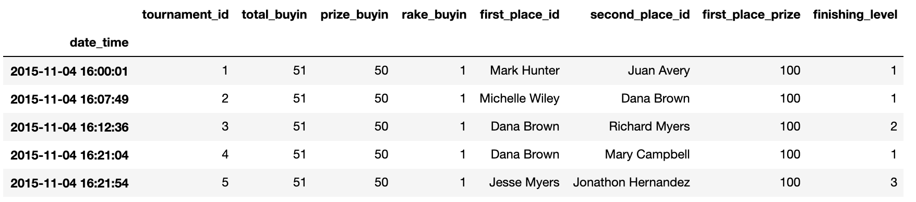
Tournament Data
Notes:
Each row represents a game

Slide 7
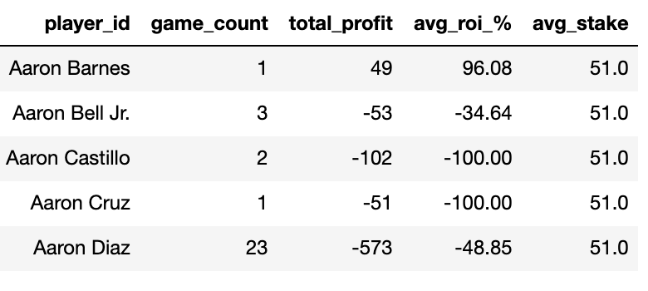
Player Data
Notes:
Each row represents player

Slide 8
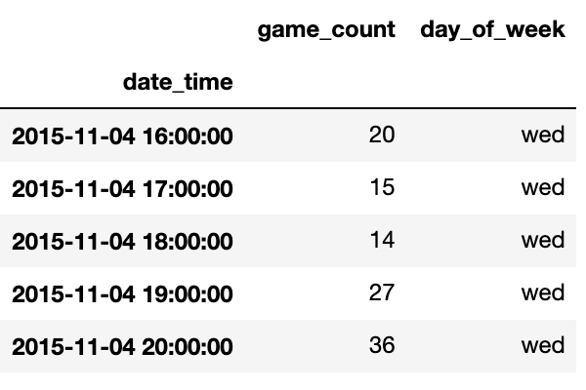
Traffic Data
Notes:
Each row represents a one hour window

Slide 9

EXPLORATORY DATA ANALYSIS
Plot, review and plot again

Slide 10
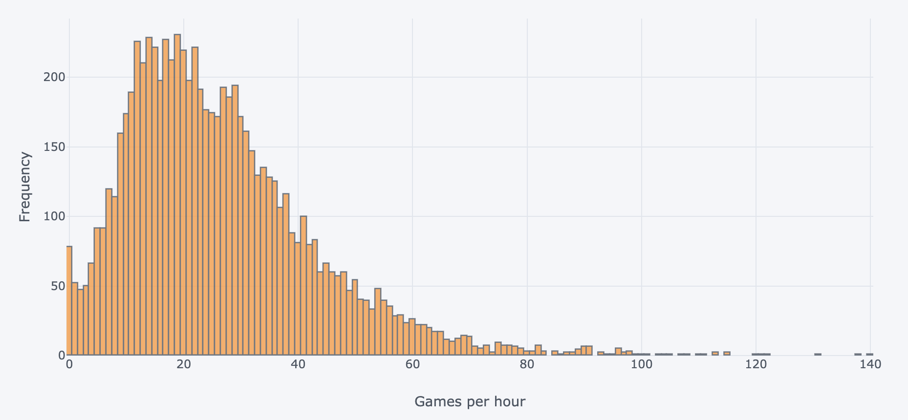
Games per hour Distribution
Notes:
Skew in the distribution
0 games per hour looks like anomaly given the distribution - within here are some hours that are not covered in the data, due to outage in hand scraping.
Inestigated instances of 0 hours and developed filling strategy. (Probably could have filled some additional low counts that could have been a result of partial outages).
QUESTION: If I’m a poker player and want to play as many games as possible, what do you think the best and worst day of the week are?

Slide 11
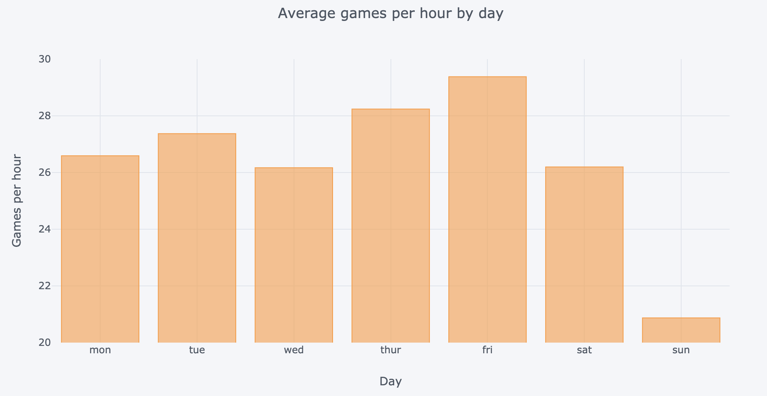
Weekdays have Higher Traffic
Notes:
This was a surprise to me, I had always assumd Saturday and Sundays were the best days to play because they are the days most people have off.
Now let’s have a look at the average week in more detail.

Slide 12
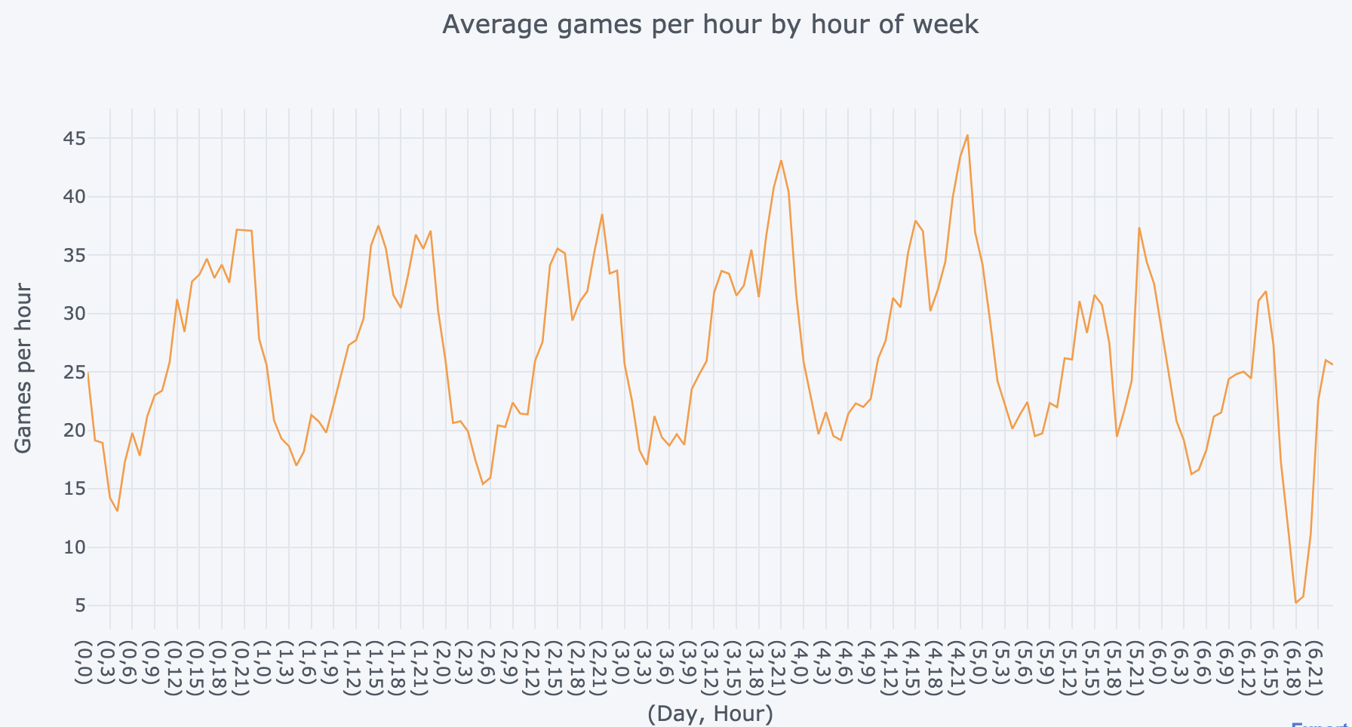
Daily Seasonal Component
Notes:
We see a regular dip around the early hours of the day, between two and five am.
We also see peaks in the evening with small dips around six pm.
This consistency indicates a majority of players play in a similair time zone, it follows what we might expect of an average day cycle (lows when people are asleep, highs when they return home from work).
There is clearly a daily seasonal component here, although Sunday has consistently lower traffic that we may consider using a weekly seasonal component for modelling.

Slide 13
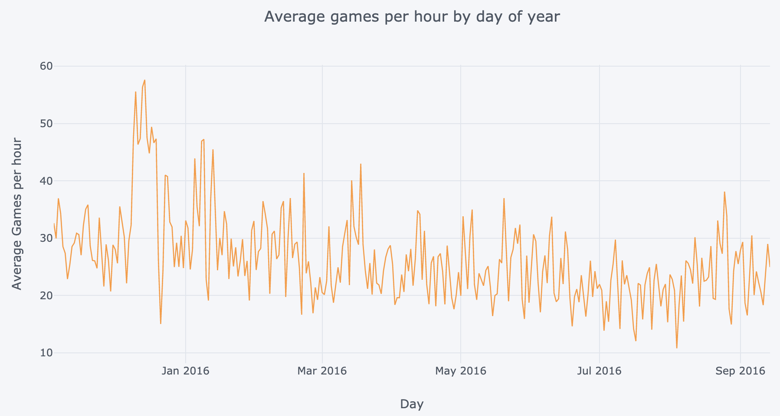
Stationary Mean?
Notes:
This is annual traffic (games per hour) resampled by day.
We see an interesting spike here around December. A promotion perhaps, definately something we should investigate.
We will need to run tests to check for stationarity.

Slide 14
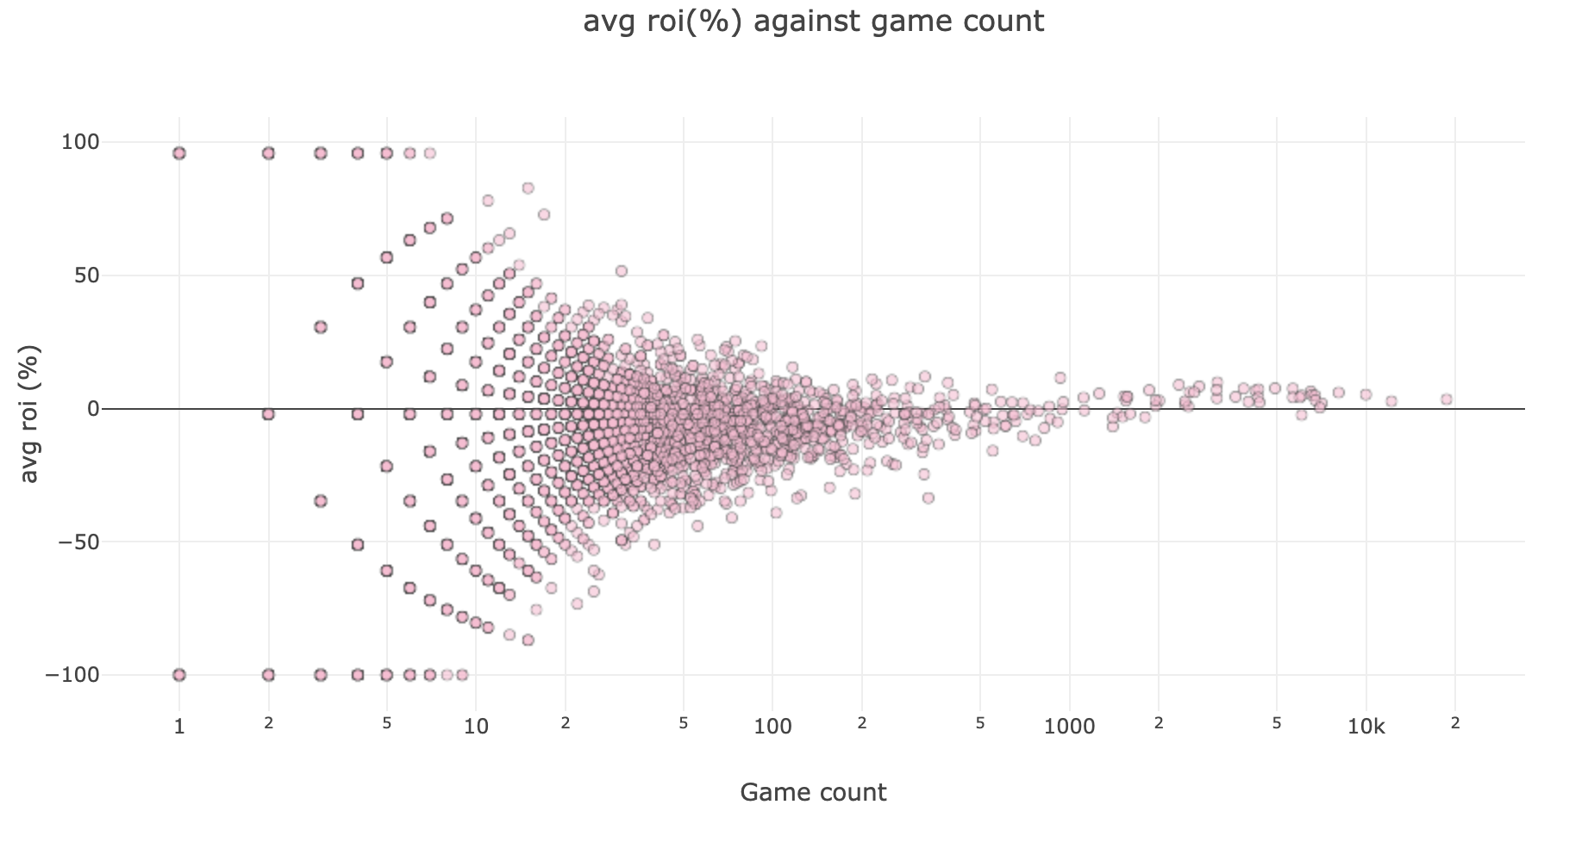
Returns on Investment are Bounded
Notes:
As game count increases, roi's are constrained to a narrower range. This reflects the increased likelihood that the average roi reflects a players true roi (as would be inferred by their skill level) as the total sample of games played increases.
Compared to other formats of poker, roi's converge in relatively short sample of games. This reflects the fact that heads up games are one of the lowest variance formats of poker - owing entirely to it being a game of two players.
Interestingly, the baseline strategy in poker involves going all in every hand. With this strategy a player would expect to win more than 30% of games over a significant sample. This is greater than -50% roi, this common sense limitation on possible roi's over large samples is also reflected in the plot.
Reassuringly, there are no anomalies on roi's for players over 1000 games, it is unlikely anybody in this sample has been able to cheat and continue playing.

Slide 15
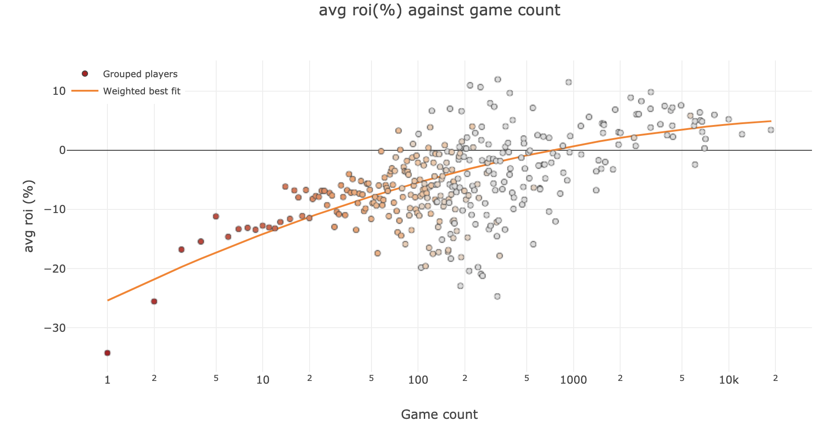
The More you Win The Longer you Play
Notes:
For this plot players have been grouped by number of game count to give the average of the average roi's.
Colour is by group density. Thousands to the left, moving to the right hundreds, tens and ones
Here we have a best guess of a players roi based on their game count. As expected, average win rates are higher for players who play more games. This demonstrates a players ability to keep playing based on their return on investment, those with negative return on investments rarely continue beyond 1000 games.
The groupingss around the middle of the graph are simialir in their game count, so are almost aribtraily grouped, but they show significant variance in returns on investment. This is a reflection of the variance in experienced return on investments, for low samples they can vary significantly.
Random sampling of results given fixed win rates corroborates this conclusion.

Slide 16
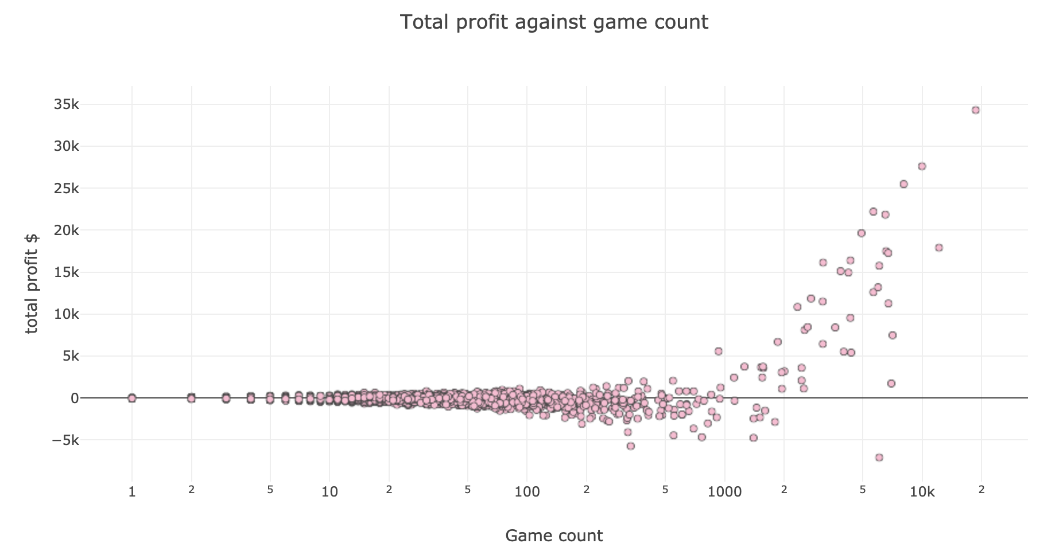
Few make a Reliable income
Notes:
Here we see that a majority of players experience a nominal win/loss over their entire player sample. Over 90% of players win or lose less than $500.
Approximately 99% of players have played less than 200 games over a year sample. Of the remaining 1%, half fall into the 200-400 games played bin, and the final half falls into a 400-19000 games played bin.
We saw in our previous plots that players with less than 400 games are predominantly losing players.
Here we begin to see the emergence of two classes of players, the majority, over 99%, are casual players with varying win rates, and a small minority, less than 1%, play more often and see sizable returns in their sample.
Broadly, we can consider the majority (>99%) recreational/novice players and a small minority (<1%) professional/winning players.

Slide 17
High volume players
Low volume players
50 players
14438 players
$432,000
-$832,000
208,000 Games
193,000 Games
17% Internal Play
10% Internal Play
Notes:
High volume= over 1000 games
Low volume = under 1000 games
Every game has two players so the game count is double the game count of the data
LOW VOLUME PLAYERS PLAY 90% OF THEIR GAMES VS HIGH VOLUME PLAYERS
HIGH VOLUME PLAYERS PLAY 83% OF THEIR GAMES VS LOW VOLUME PLAYERS
MOST POKER TRAFFIC IS BETWEEN THIS GROUPS - NOT WITHIN THEM
To investigate the circumstances of the internal play rate for the high volume players we construct a pairwise matrix of games played between opponents for the top 20 players by profit and top 20 by games played.
25 players are in this dataframe, showing a high overlap between the top 20 players by profit and top 20 by volume.
All players in the dataframe have game counts above 2000. Despite this they all play almost no games with each other. Such small game counts between the most frequent players, who are all (but one) winners, demonstrates that some winning players make an active effort to avoid playing with each other.
We see in the sample there is one player who plays a large number of games against the other professionals, despite such strong opponents their roi is not much lower than the sunk cost (rake) associated with each game. This player is likely a better than average player who experiences low returns because they play most of their games against other professionals.

Slide 18
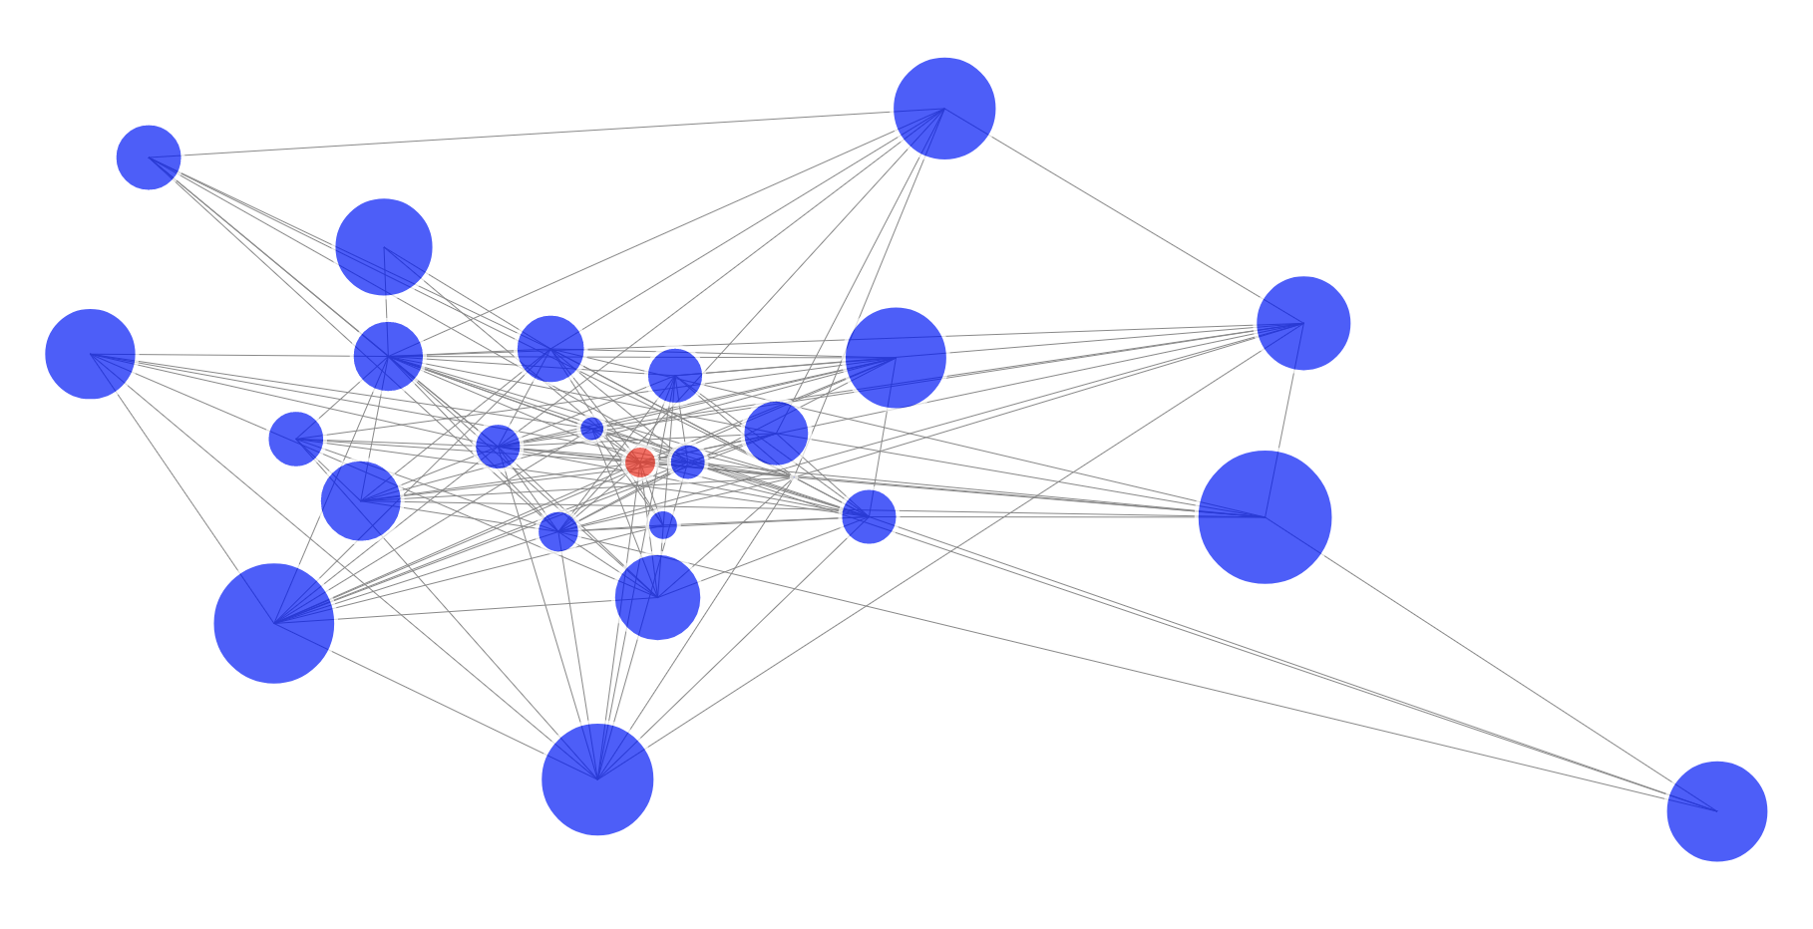
Looking for a Promotion
Notes:
Colour of circle; blue=profit, red=loss Size of circle; Average roi. Distance between circles; closesness (the number of games)
Two things are noteworthy here, that the losing player plays most (almost 90%) of their games against within this group. They seem to make an effort to avoid the players with the highest average roi's - as indicated by the distance from the larger circles.
Here we start to see the reality in the life of professional heads up players….
Professional players make an active effort to avoid playing each other. This arises as a result of playing each other at some point in the past. To enter the fold of professionals, players must prove themselves by playing existing professionals - to improve their chances of success they focus their efforts on the weaker existing professionals.
The original remit of this project is to provide information that increases a players expected profitability. If this component of player traffic, professionals vs aspiring professionals, yields no profit for the average established professional, we can consider removing these instances from the hourly traffic sample before forecasting traffic. In this way we are forecasting the traffic that professional players are interested in - games that involve recreational players only.
To do this we must classify each player as recreational or professional

Slide 19
EDA Conclusions
Seasonal component to hourly traffic
Missed values in hourly traffic need to be filled
Two classes of players: professional and recreational
Severe class imbalance in player classifications
Notes:
Traffic has a seaonal component, daily or weekly.
Hours need to be filled in.
Two classes of players. If I classify the players, I can create a time series of games per hour that include at least one recreational player and the number professionals online per hour (if you’re a pro, this is the number of people you have to share your pie with). Professionals would be the most likely customers of a traffic forecasting tool, and this is the traffic they are most interested in.
We do however run into a problem, roi’s with low game counts aren’t a reflection of skill like high ones are, and we have a sever class imbalance. It is likely we would need data from multiple buyins or a longer time period to get a clear picture of how roi’s, profit, game count and player networks can be used to classify players.
For now we are stuck manually classifying the 14,000 players.

Slide 20
Classifying Players
CRITERIA | CLASSIFICATION
<1000 GAMES | RECREATIONAL
>1500 GAMES, >0 ROI | PROFESSIONAL
>1500 GAMES, >9 GAMES PER HOUR | PROFESSIONAL
>0 ROI | PROFESSIONAL
> 7 GAMES PER HOUR | PROFESSIONAL
REMAINING | RECREATIONAL
Notes:
Roi is an inaccurate measure of skill below 1000 games, they are all considered recs
50 players remaining.
9 players remaining after 3rd slice
We are likely to have misclassified some players, but classification is arguable subjective anyway. There is a preference for false negatives over false positives (in that way we prefer to misclassify components of traffic that happen less frequently). Of course if your rolling this out as a product, customisable classifications we be a must have feature.
I ended up with 48 players classed as professional

Slide 21
EXPLORATORY DATA ANALYSIS
Plot, review and plot again
Notes:
EDA with classfied players

Slide 22
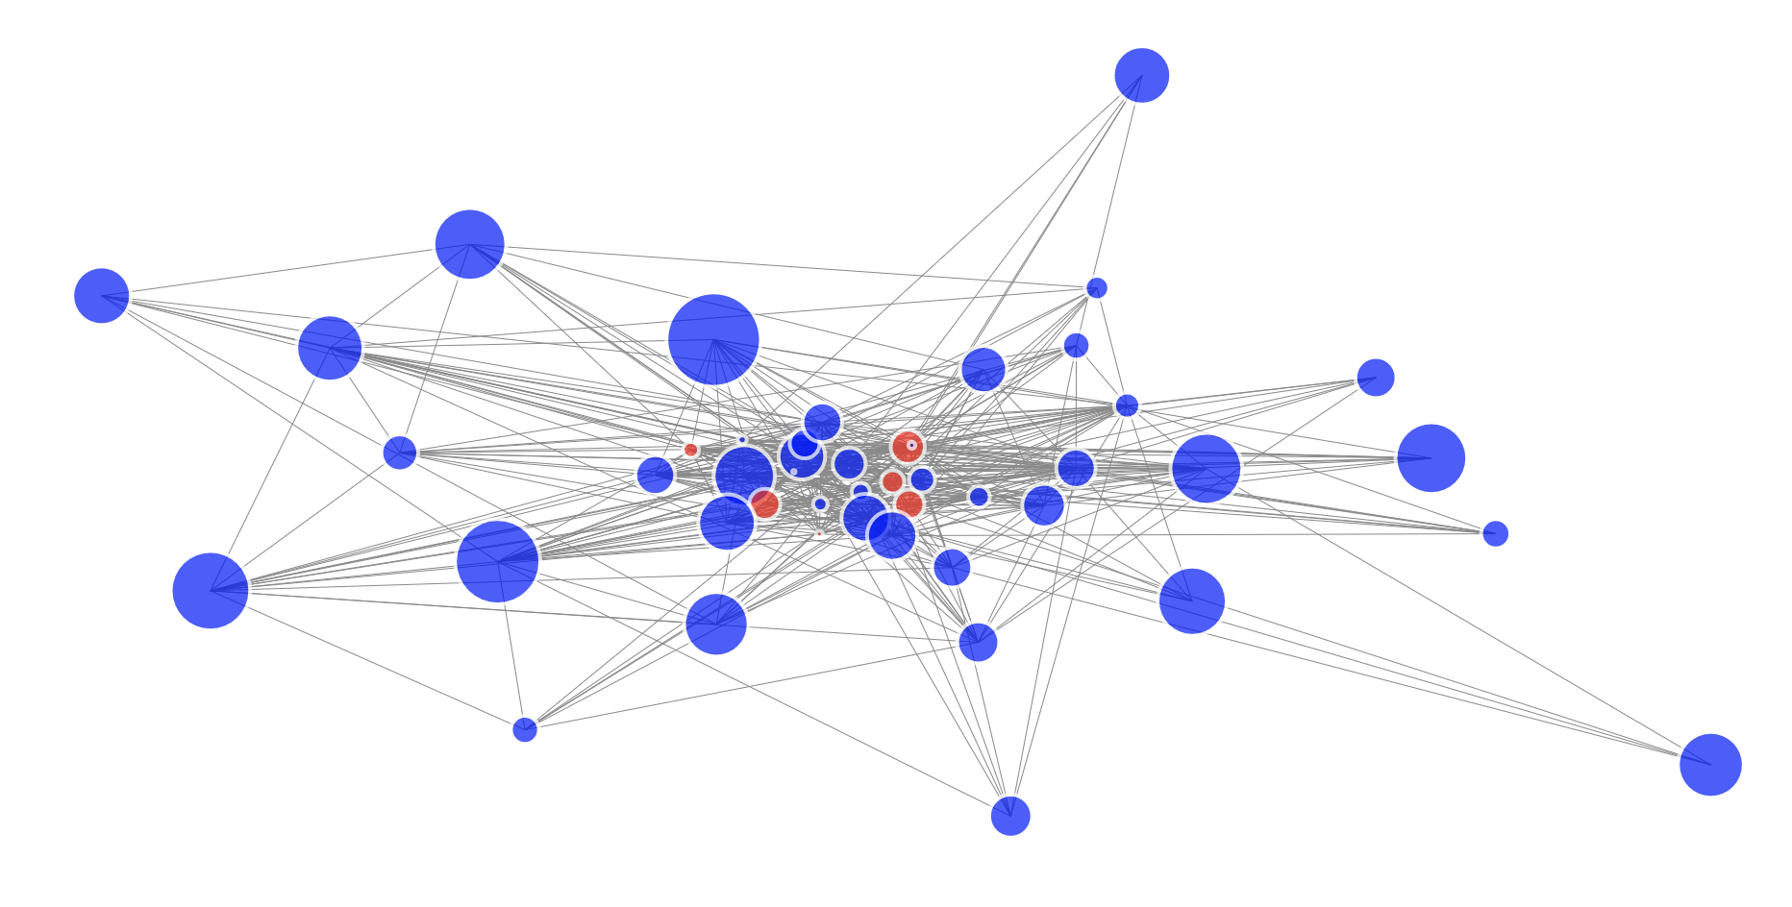
All Professionals The Network

Slide 23
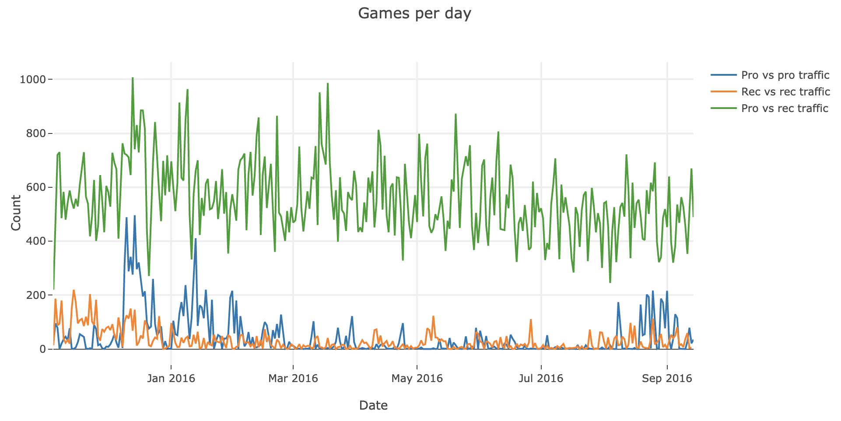
Hourly Traffic by Player Category
Notes:
The spike in August reveals it’s cause, a small war broke out between a group of professionals. It didn’t last long.
Given the pro vs recreational payer traffic also spikes there it’s quite likely there are some who play professionally who have not been classified as such due to low roi or game count.

Slide 24
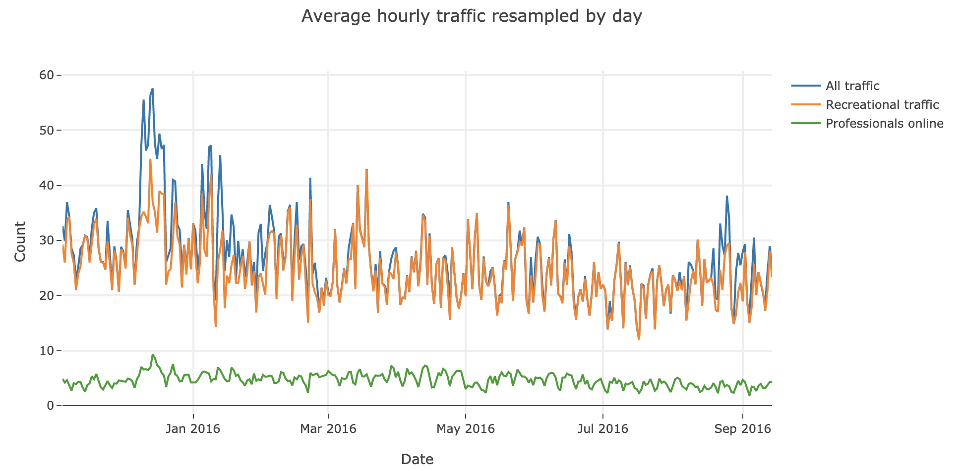
Time Series to Model
Notes:
These are the three time series I modelled.

Slide 25
TIME SERIES MODELLING
Perform model tests, optimise parameters and assess models

Slide 26
Model Tests
Check for stationarity (Dickey-Fuller Test)
Evaluate autocorrelation and partial autocorrelation
Evaluate common sense baseline (previous hours true value)
Notes:
All time series passed the dickey fuller test. To be specific… In all three instances the probability of observing greater than test statistic given the null hypothesis is true is extremely small; we are confident we can effectively model on this representation of the time series (as opposed to a differenced version of the time series).
Auto correlations showed that for pros and all traffic, a lag of 24 hours has the highest correlation with the present value. For traffic including one recreational a lag of 168 hours (one week) had the best correlation with present value.
A common sense baseline of making a prediction equal to the last hours traffic performs better than taking the global mean. It’s worth noting that this is a high standard common sense baseline that would require some kind of programme to forecast on that basis.

Slide 27
Success Metrics
Improvement on common sense baseline
Mean Absolute Error
R-squared score
Residuals, residuals, residuals!
Notes:
My preference is to score on mean absolute error and r2 score as performance metrics. We prefer this over the mean squared error because every predicted game is equally valuable to a professional (larger errors need not be penalised more). However there is certainly arguement from a commercial perspective to focus on mean squared error because of how you think customers will respond to large errors in predictions (vs more small errors).
Use the r2 score to understand how much of the varinance we have accounted for with our model.
Residuals are one of the most important measures of success for the models. Poker players are used to high variance in outcomes - a model with high variance is appealing to them as long as it is expected to be viable in the long run. Normally distributed residuals are consistent with a stochastic (random) error.

Slide 28
MODELLING TIME
Seasonal AutoRegressive Moving Average Model
StatsModels Library
statsmodels.tsa.statespace.sarimax.SARIMAX
Notes:
It’s worth noting StatsModels SARIMAX optimises for mean squared error. The commercial considerations meant that I’m happy to optimise for MSE and pick the model with the lowest MAE. There are a number of ways to configure that approach and if I continue this further I will look to optimise for MAE, but I’ll have to run models in R instead of Python for that.
I created a model diagnostics report was created, for loops were ran on the model parameters to establish the model parameters that performed best.
I tried resampling for 2 and 4 hour windows but it did nothing to improve the model, and in some cases, due to the reduction in sample size, led to the model being unable to converge. One hour one step ahead models performed best in every case.
I also evluated two step ahead predictions using dynamic forecasts of the one step ahead model. Again more work can be done here with different modelling approaches like a straight two step ahead model.

Slide 29
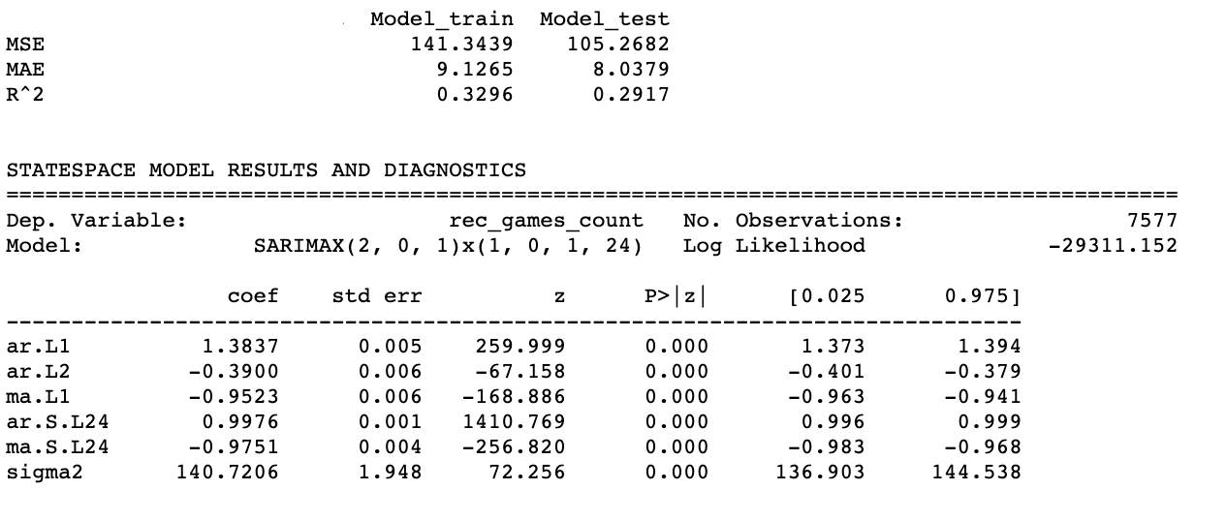
Model Report Recreational Traffic
Baseline_test
147.24
9,28
0.01
Notes:
I won’t bore you too much with this but this is my basic text report for revieing models. Most important are the scores and the model parameters.
Model has problems converging with one week lag so I settled for 24.
Number of lags and moving averages are low, not going to be expensive computationally to retrain the model between obervations.
A good boost in the r2 score, and a small drop in MAE, about 13%. With better player classifications and more data I’d expect a higher score to be achievable. I could also try optimising for MAE.

Slide 30
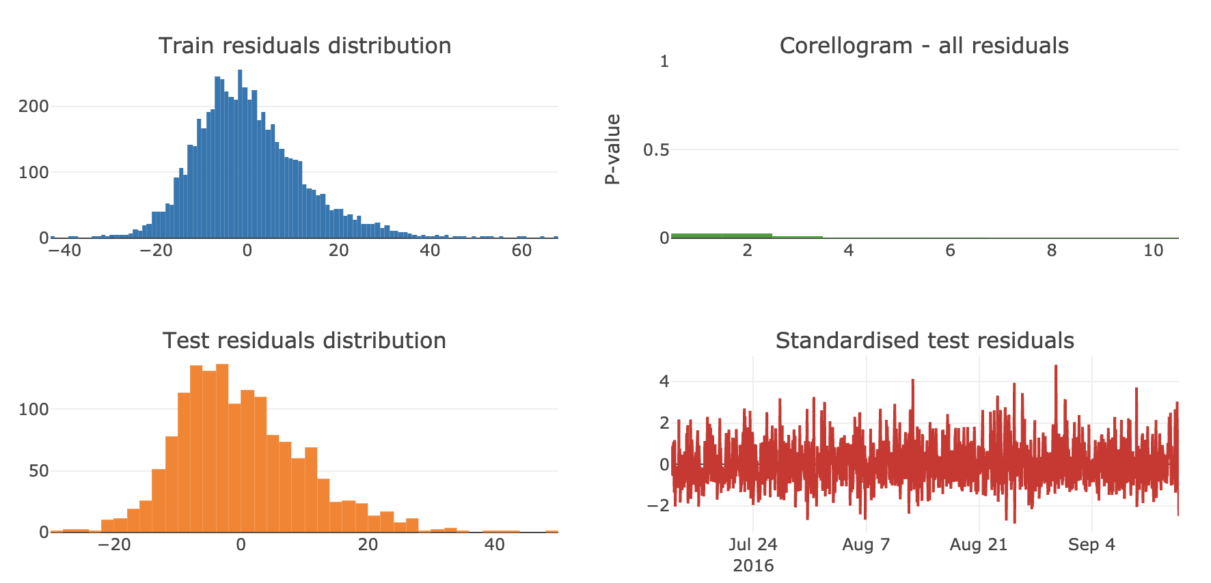
Model Diagnostics
Notes:
Residuals look ok, a slight tendency to overestimate.
No corelation between residuals, we like that. Standardised residuals over time look stable.

Slide 31
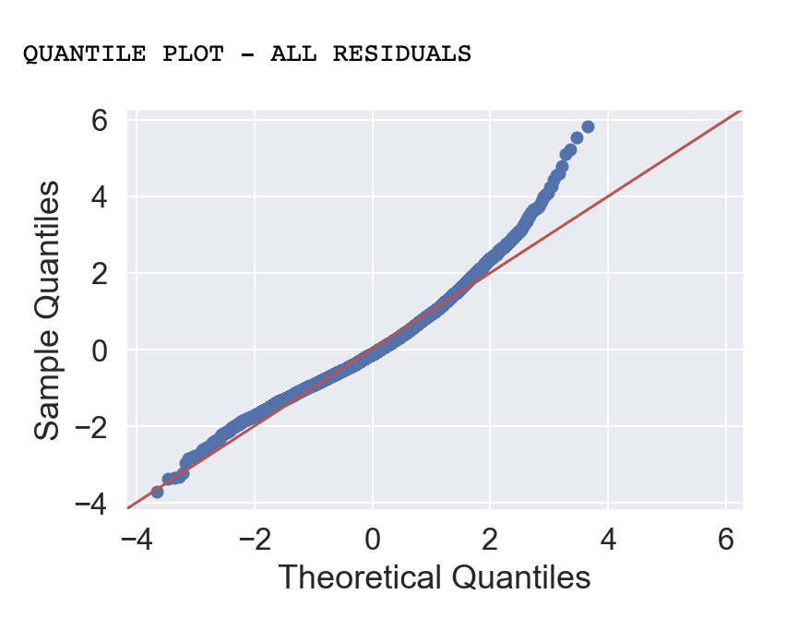
Model Diagnostics
Notes:
Check a quantile plot whilst I’m at it.
See more clearly that skew in the residuals, that tendency to over estimate traffic.

Slide 32
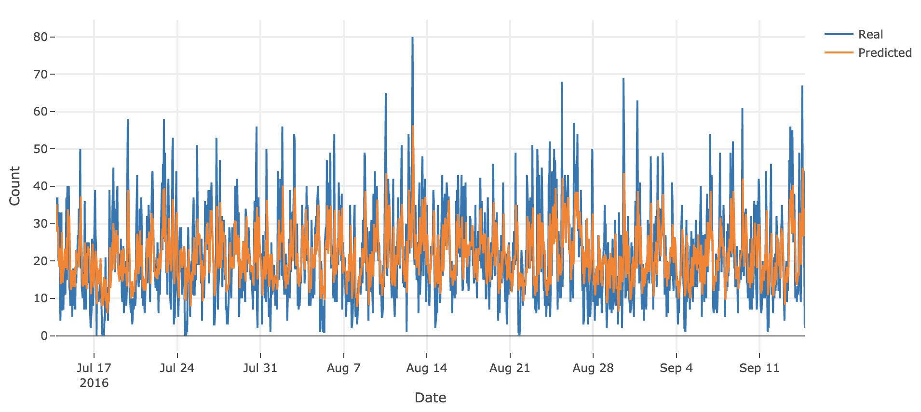
Model Report One Step Forecast
Notes:
One step ahead forecast.

Slide 33
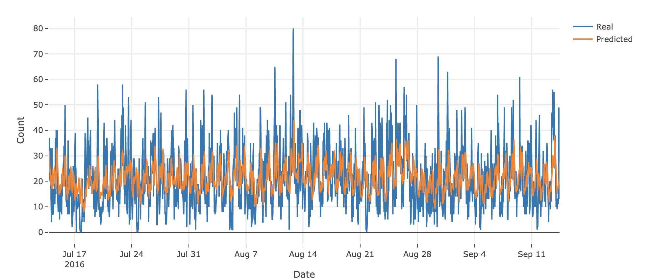
Model Report Two Step Forecast
Notes:
Two step ahead forecasts created by running a for loop on dynamic forecasts with each starting time in test.
See a drop in r2 score by .1.

Slide 34
Model Roundup
Model | MAE | MAE Improvement | R-squared | R-squared Improvement
All traffic | 8.91 | -1.33 (-13.0%) | .32 | .26
Recreational traffic | 8.05 | -1.26 (-13.5%) | .29 | .28
Professionals online | .95 | -.10 (-9.5%) | .51 | .16
Notes:
All figures are for test sets, which is the last fifth of the data set
Professionals online are a lot more predictable than other forms of traffic, the common sense baseline had a .35 r2 value.
So for the forecasts we have an improvement on what’s effectively a high standard baseline.
We got good jumps in r2 score.
We’re pretty sure there’s room from improvement particulalry if players are more accuratly classified.
We know there are existing solutions for setting up a data pipeline that will allow for the collection of game summaries fast enough to be used for predictions.
We have the building blocks for a poker traffic forecasting product.

Slide 35
Traffic Forecast
Subscription Service
Offered as add on to hand scraping service membership
Pricing dependent on buy in level
Regular Retraining
Retrain models between observations (same parameters)
Optimise models weekly (optimise parameters)
Customisable Classifications and Notifications
Option to toggle player classifications
Prompt user to classify borderline players
Custom alerts
Notes:
Working with a company that already has a large supply of scraped hands we can implement time series forecasts on traffic and the number of professionals online for each buyin level.
Forecast pricing will be dependent on the buyin level being forecasted.
To improve forecast accuracy players should have the option to toggle player classification, and be presented with players who are more difficult to classify.

Slide 36
Player Report
Regular Playing Times
Covertly manage relationships with other players
Avoid the strong, hunt the weak
Player Classifications
Classifications based on global results
Classifications based on pairwise relationships
Customisable Interactive Visualisations
Individuals and groups (population tendencies)
Frequently played network graph, cumulative profit
Characteristics of player sets - by buy in and volume
Notes:
Because who doesn’t love an interactive network graph.
Advanced functionality like this is not available through existing products like sharkScope. As long as there is acces to the data, you could provide customers with customisable and interactive data visualisations of aggregate statistics, player classifications and information on the regular playing time of players - allowing professionals to covertly manage their relationships with each other (to hunt down or avoid).
There are no features that allow for agregate statistics on player groups (grouped by game count, or most frequent buyin), access to these summary statistics help can help a player choose the most appropriate buy in level to play. Understanding the average population statistics of classes of players can also help professionals developed their default strategy against unknown players.
.

Slide 37
Thanks for Watching
Notes:
Questions.

